Slide 1

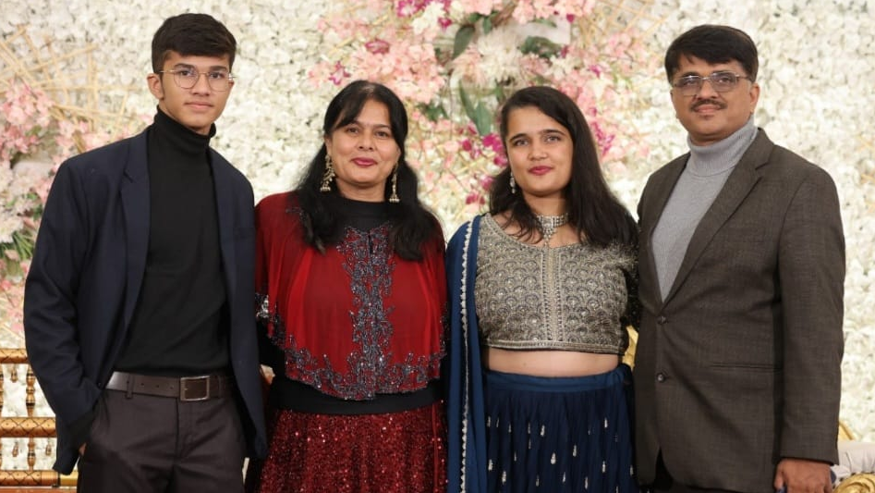
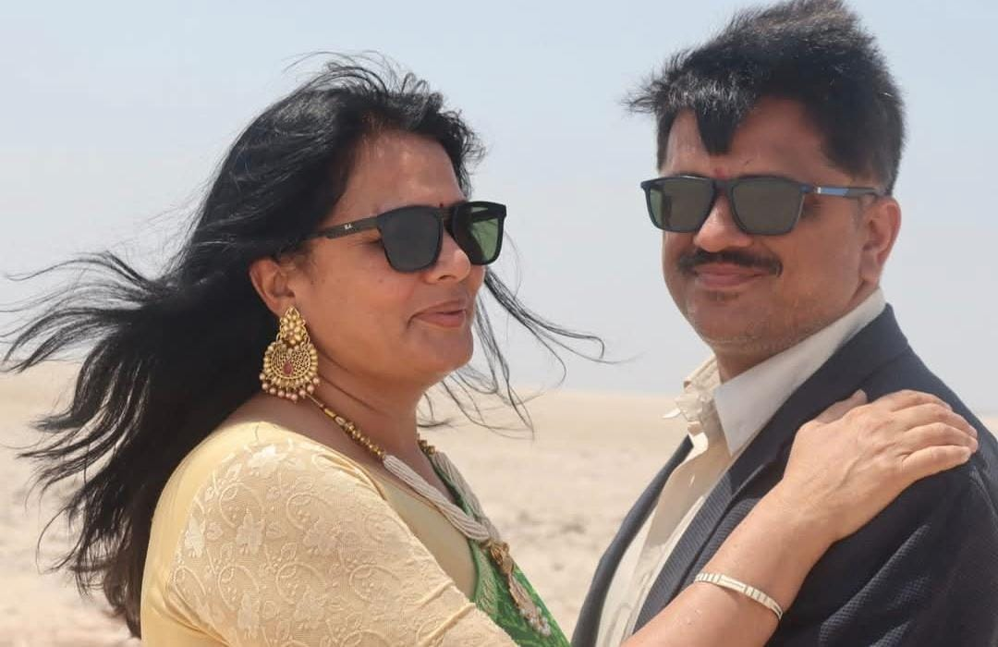

BHAVINI
YAGNESH
BEST COUPLE
25th Yagnesh – Bhavini Wedding Anniversary

Slide 2
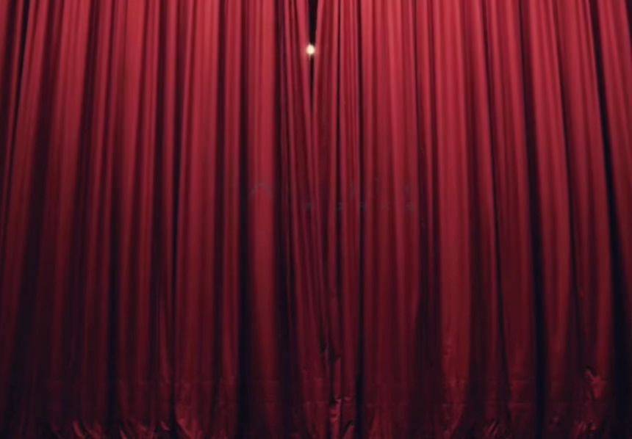

Slide 3
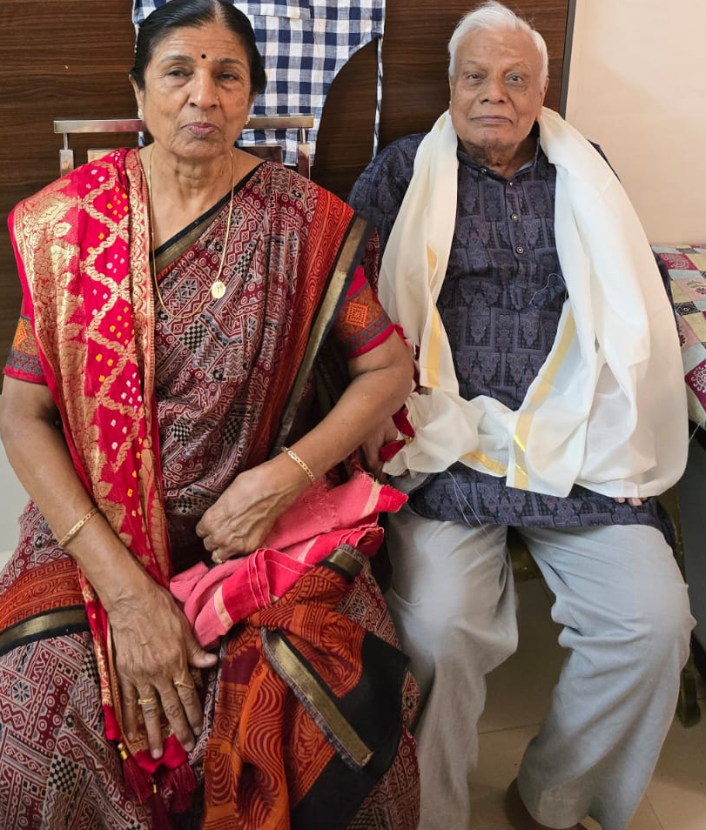
Renu Ba
Rasik Dada
Together Forever Award
25th Yagnesh – Bhavini Wedding Anniversary

Slide 5
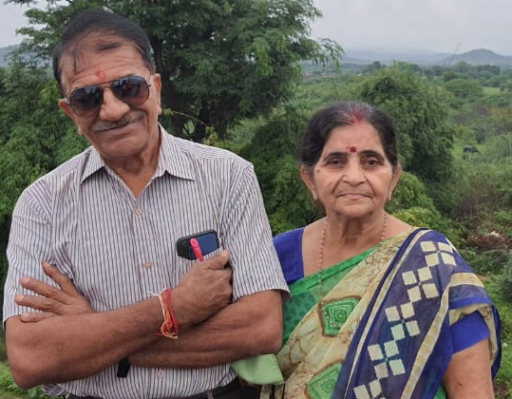
Bhupatray
Susila
Evergreen Lovebirds Award
25th Yagnesh – Bhavini Wedding Anniversary

Slide 7
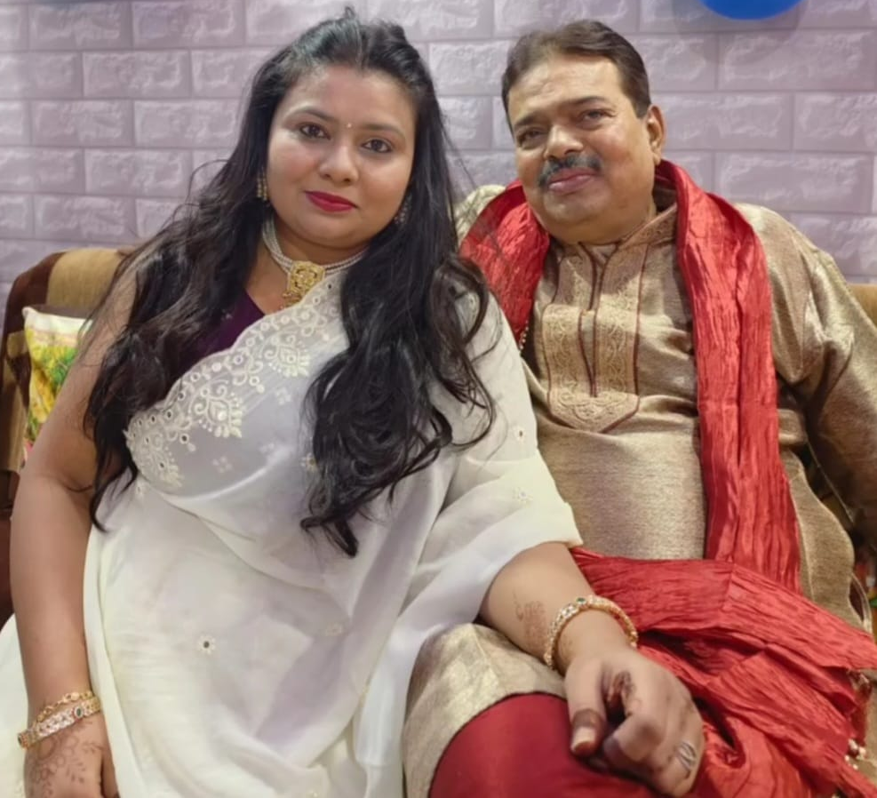
Dipti
Kiran
Sunshine Pair Award
25th Yagnesh – Bhavini Wedding Anniversary

Slide 9
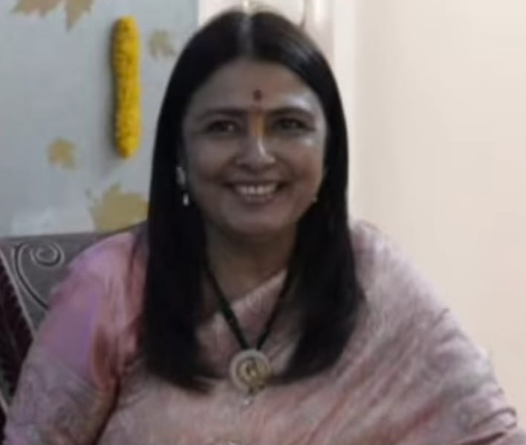
Neha
Best Caring Mother
25th Yagnesh – Bhavini Wedding Anniversary

Slide 11

Janhavi
Gaurav
Radiant Romance Award
25th Yagnesh – Bhavini Wedding Anniversary

Slide 13
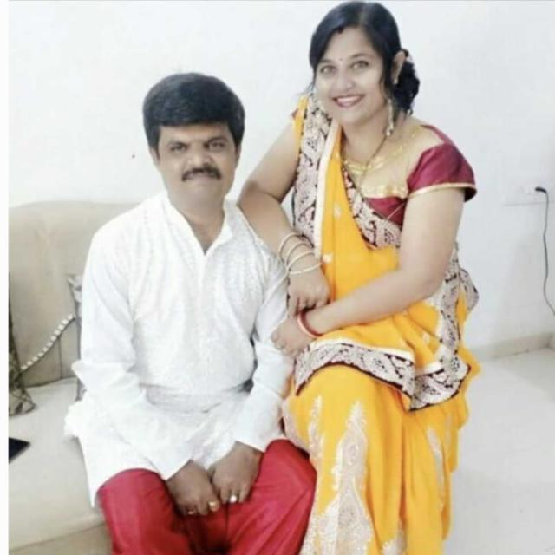
Manish
Fulva
Energetic couple
25th Yagnesh – Bhavini Wedding Anniversary

Slide 15
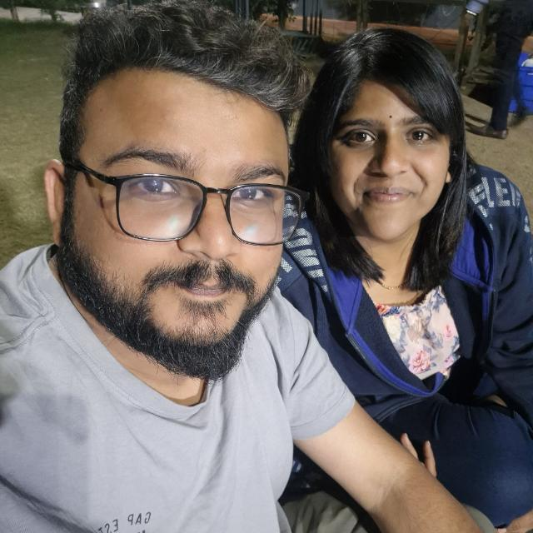
Munjal
Shivani
Most Supportive Pair
25th Yagnesh – Bhavini Wedding Anniversary

Slide 17
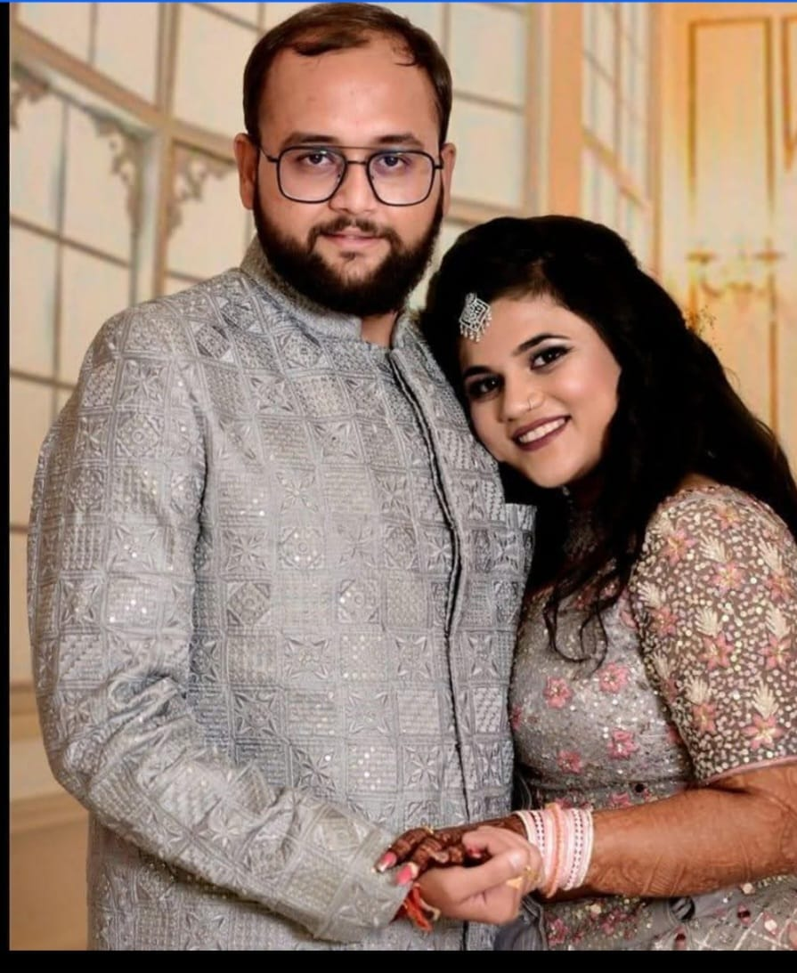
Abhishek
Arpita
Inseparable Souls Award
25th Yagnesh – Bhavini Wedding Anniversary

Slide 19
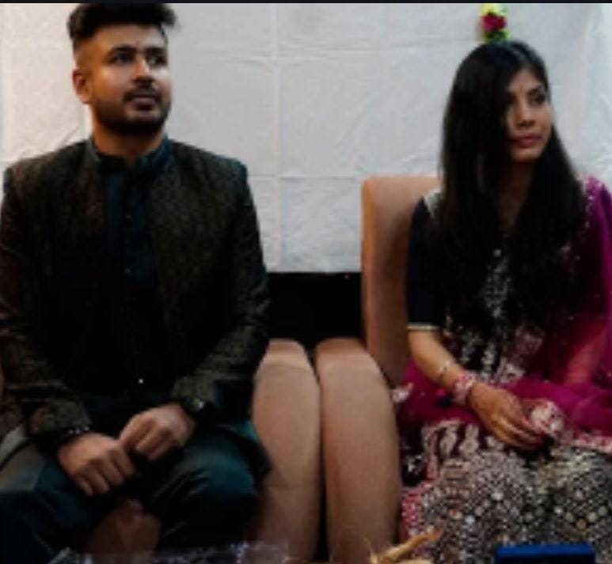
Siddhant
Srishti
The Graceful Bond
25th Yagnesh – Bhavini Wedding Anniversary

Slide 21
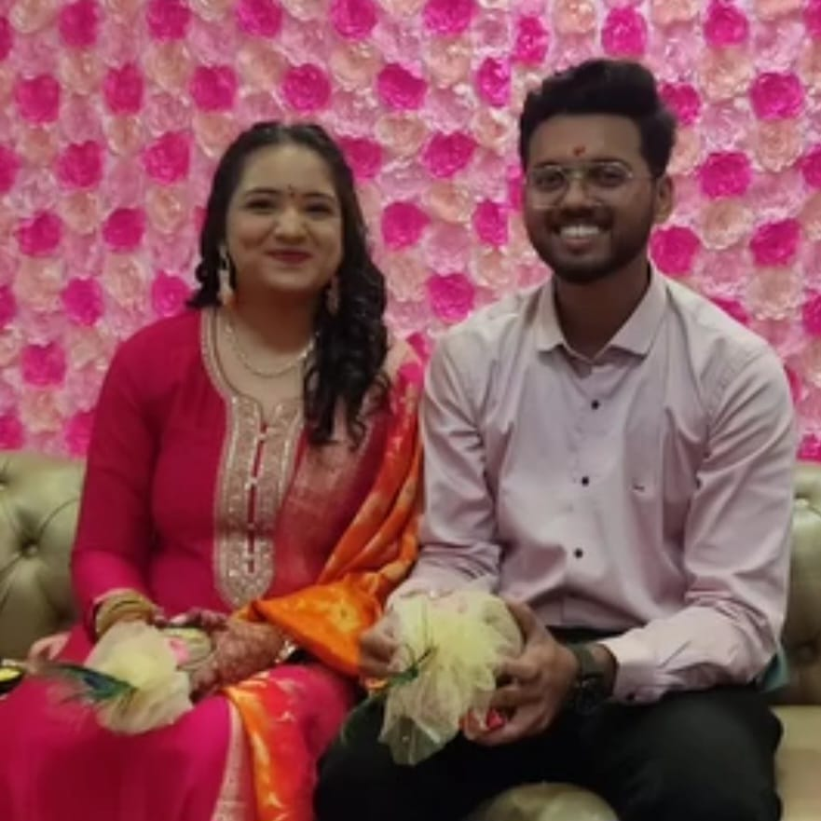
Bansi
Apurva
Young at Heart Award
25th Yagnesh – Bhavini Wedding Anniversary

Slide 23
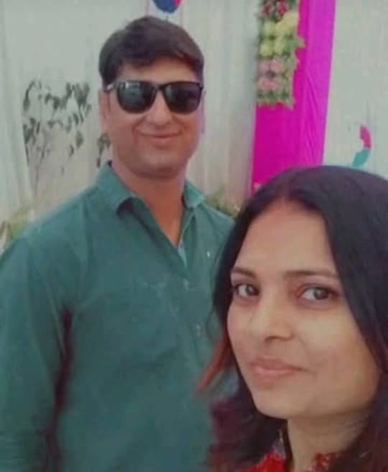
Vishal
Smita
Harmony Award
25th Yagnesh – Bhavini Wedding Anniversary

Slide 25
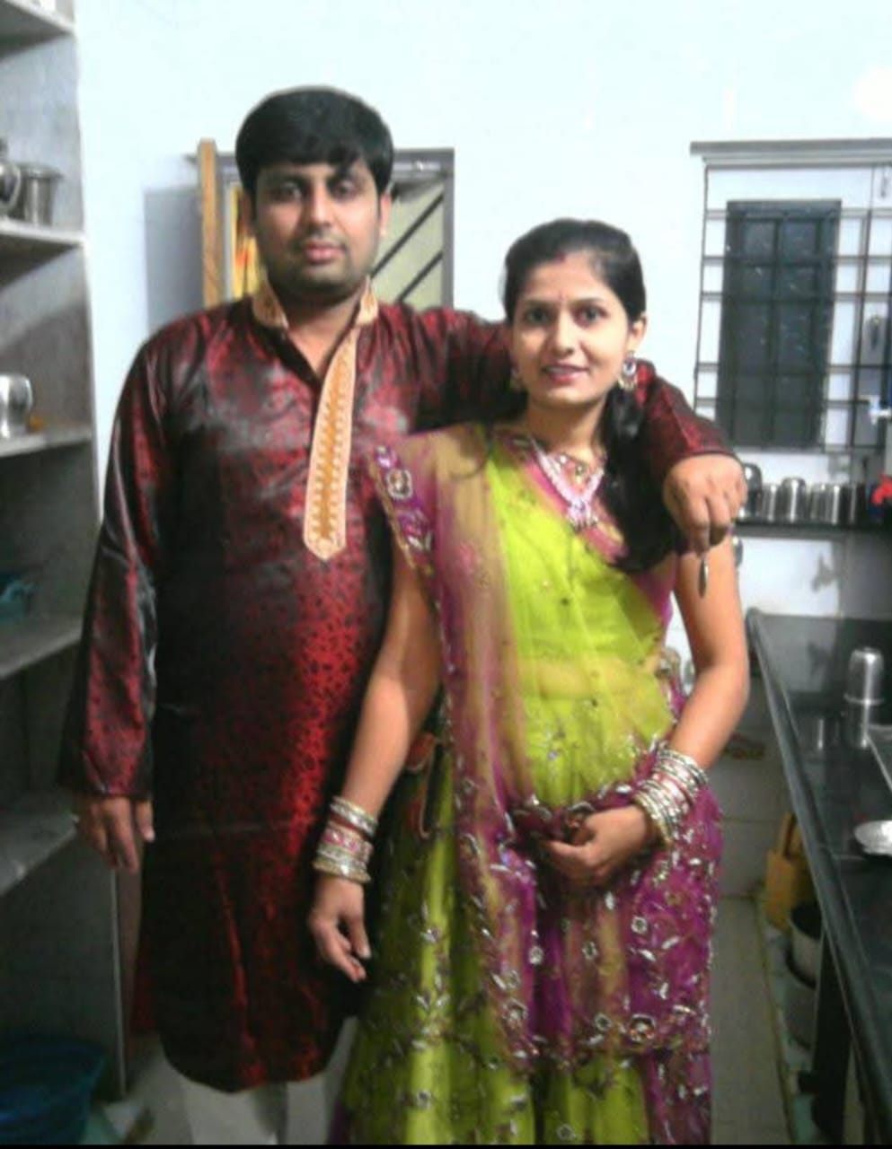
Bhavik
Siddhi
Power couple Award
25th Yagnesh – Bhavini Wedding Anniversary

Slide 27
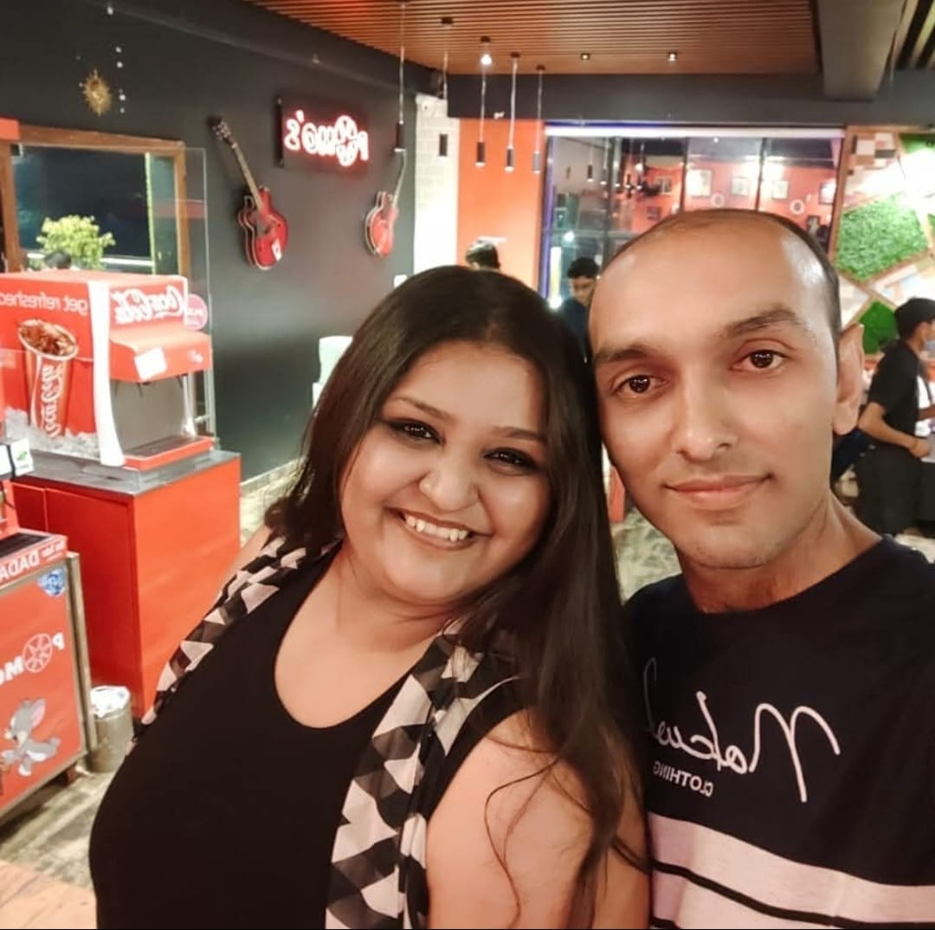
Hardika
Mayank
Unity in Diversity Award
25th Yagnesh – Bhavini Wedding Anniversary

Slide 29
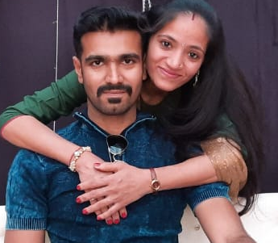
Sandeep
Riddhi
Unbreakable Bond Award
25th Yagnesh – Bhavini Wedding Anniversary

Slide 31
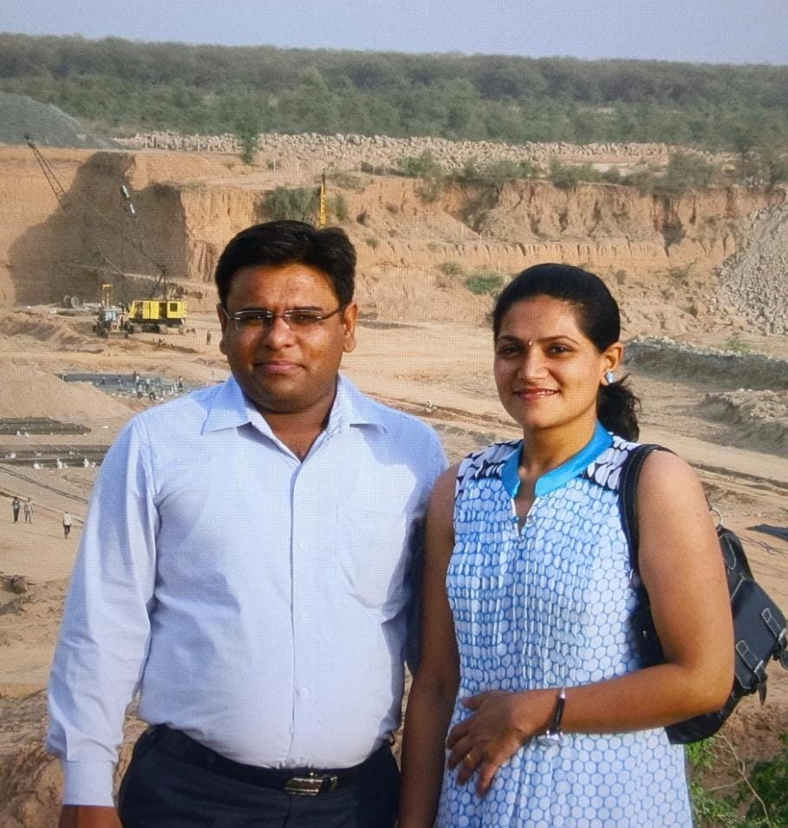
Maulik
Amruta
Soulful Synergy Award
25th Yagnesh – Bhavini Wedding Anniversary

Slide 33
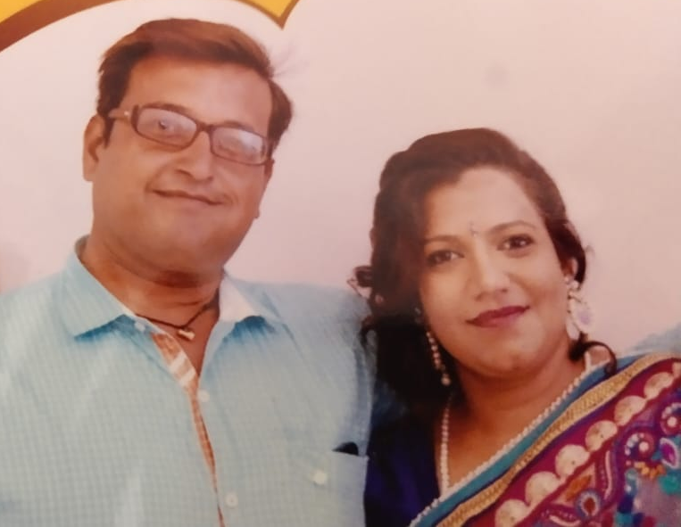
Prashant
Jignasa
Lifetime Companions Award
25th Yagnesh – Bhavini Wedding Anniversary

Slide 35
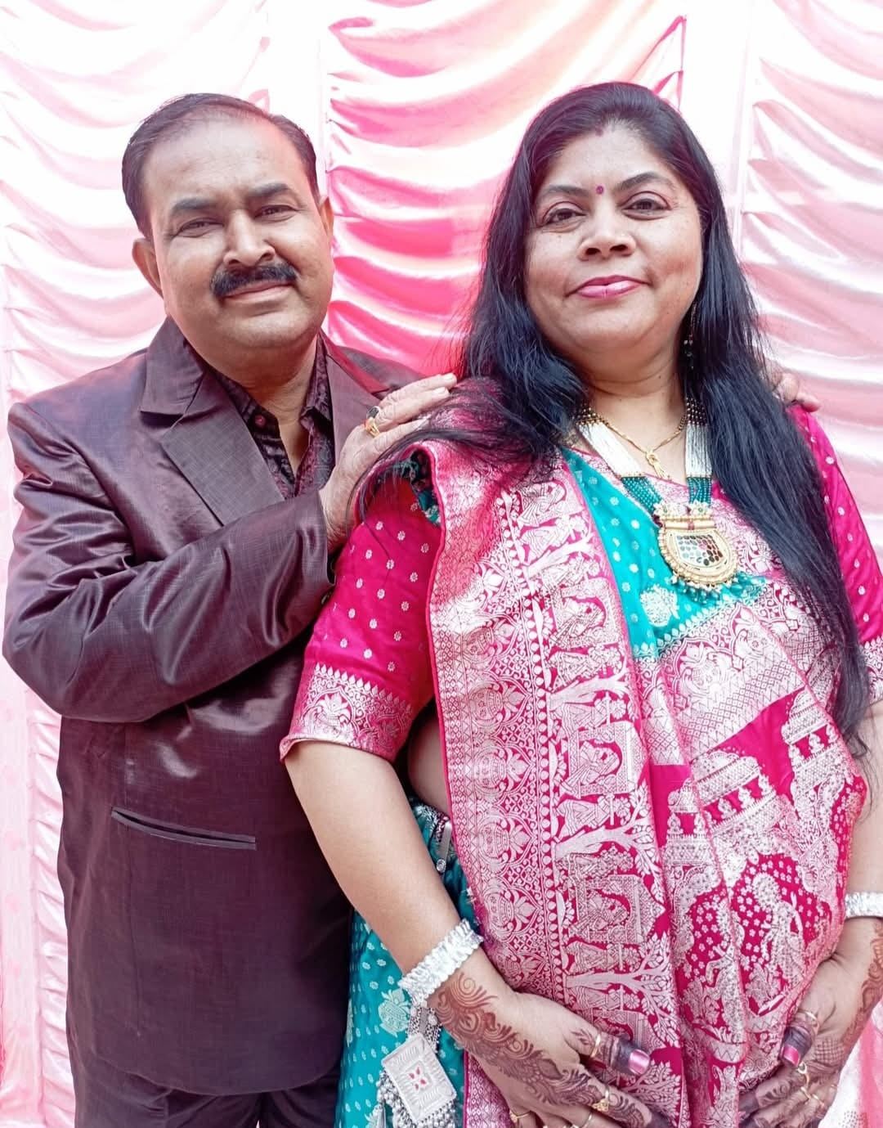
Anand
Heena
Laughter Legends
25th Yagnesh – Bhavini Wedding Anniversary

Slide 37
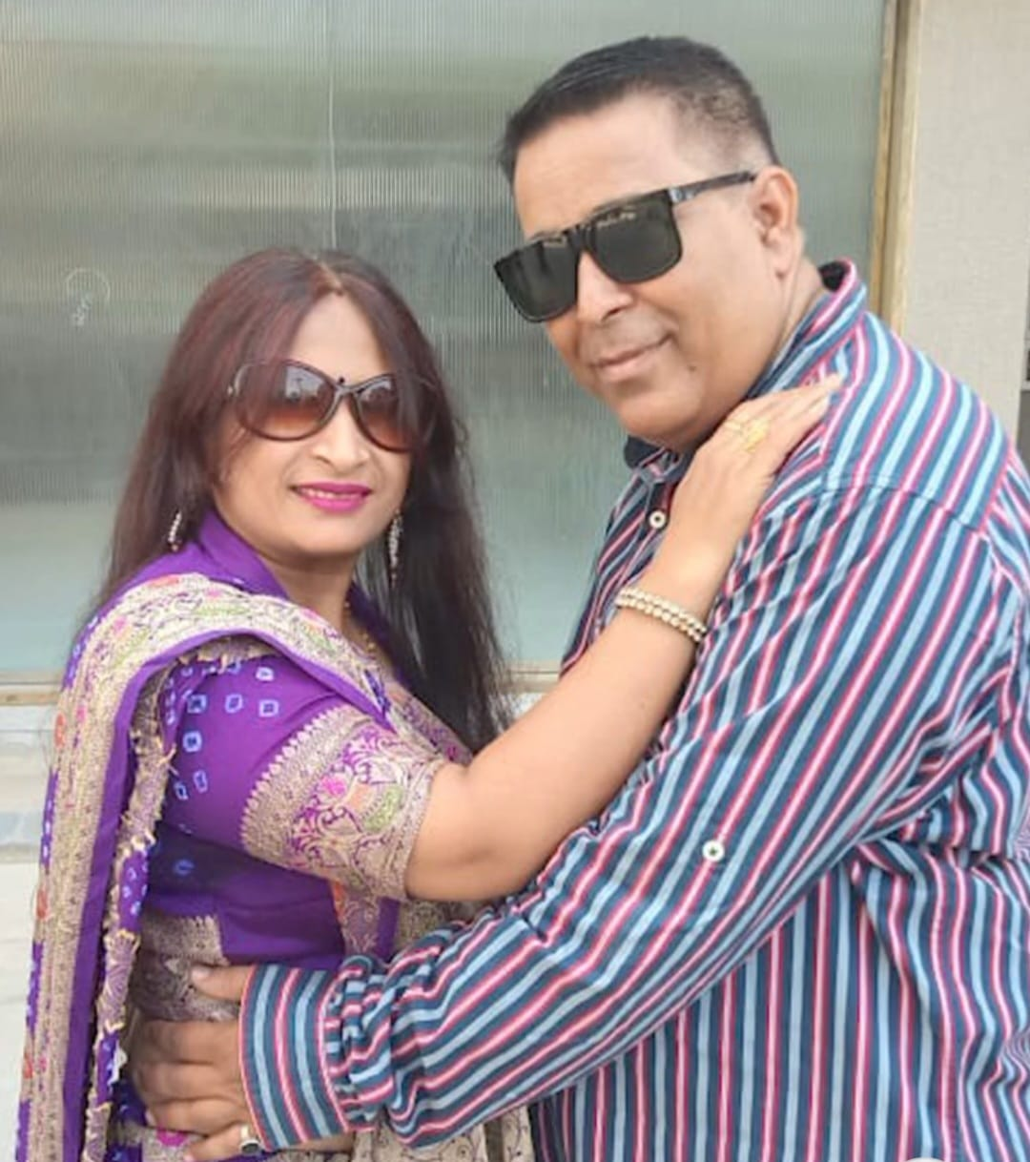
Bhavika
Kaushal
Sweet & Simple Award
25th Yagnesh – Bhavini Wedding Anniversary

Slide 39
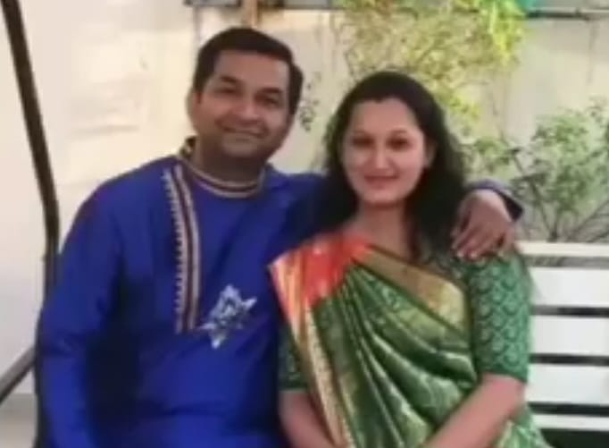
Ankur
Deepa
Classy Couple Award
25th Yagnesh – Bhavini Wedding Anniversary

Slide 41
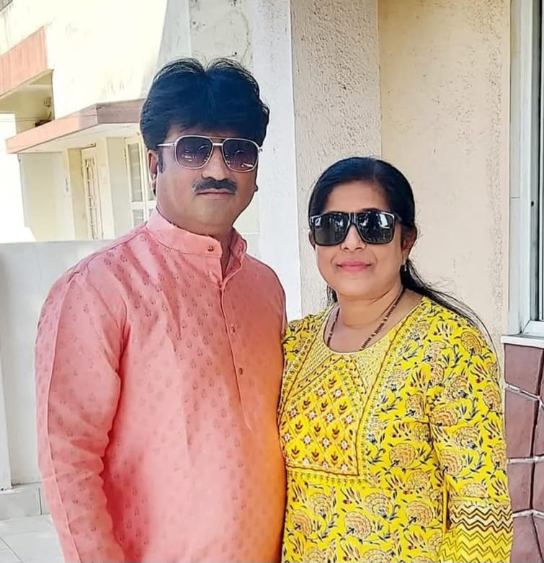
Mayur
Krishna
Cherished Bond Award
25th Yagnesh – Bhavini Wedding Anniversary

Slide 43
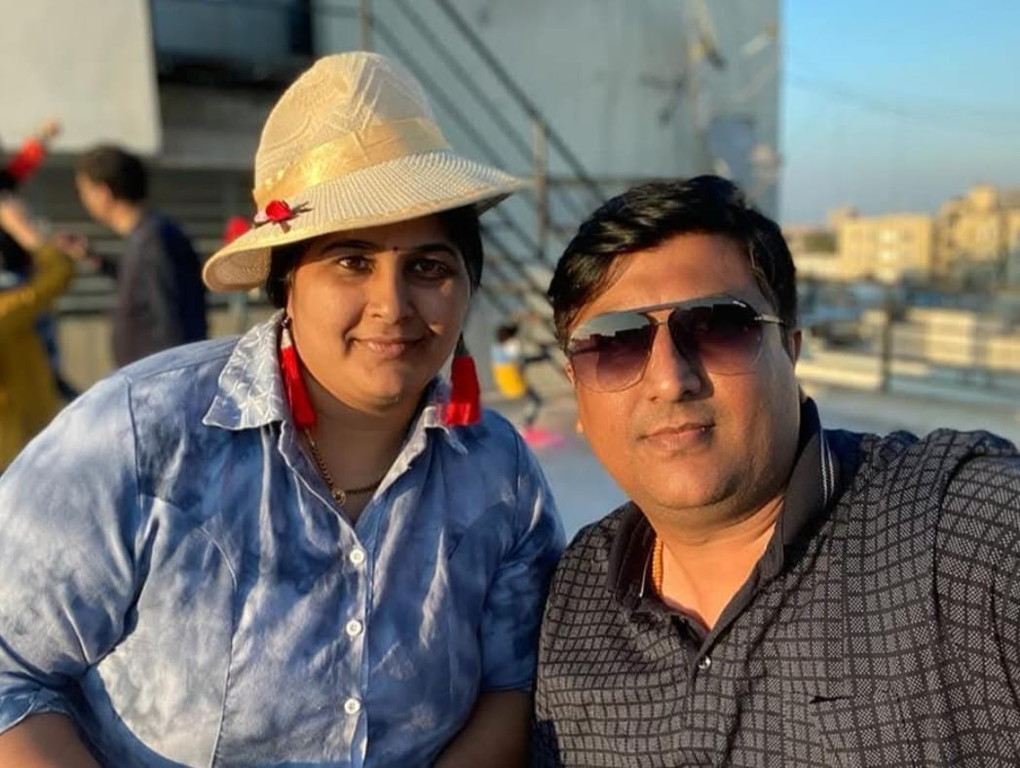
Divya
Pranjal
Timeless Togetherness Award
25th Yagnesh – Bhavini Wedding Anniversary

Slide 45
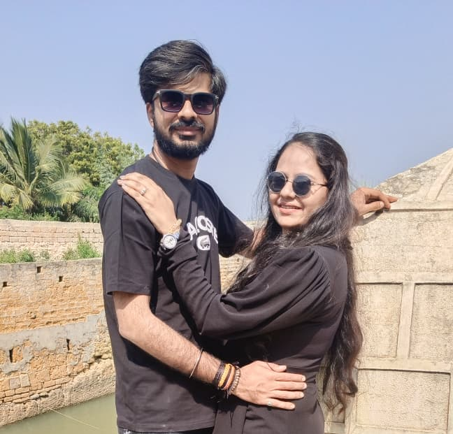
Raj
Falguni
Adorable Duo Award
25th Yagnesh – Bhavini Wedding Anniversary

Slide 47
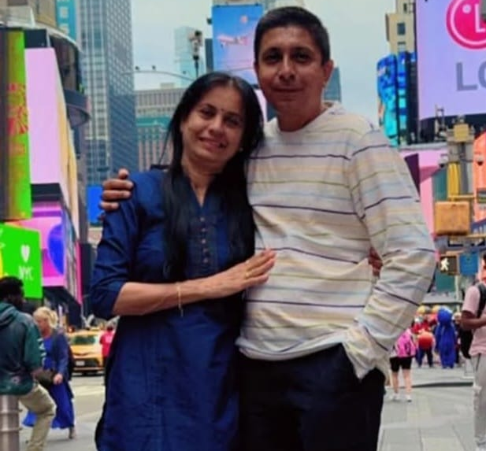
Sonal
Chetan
Graceful Duo Award
25th Yagnesh – Bhavini Wedding Anniversary

Slide 49
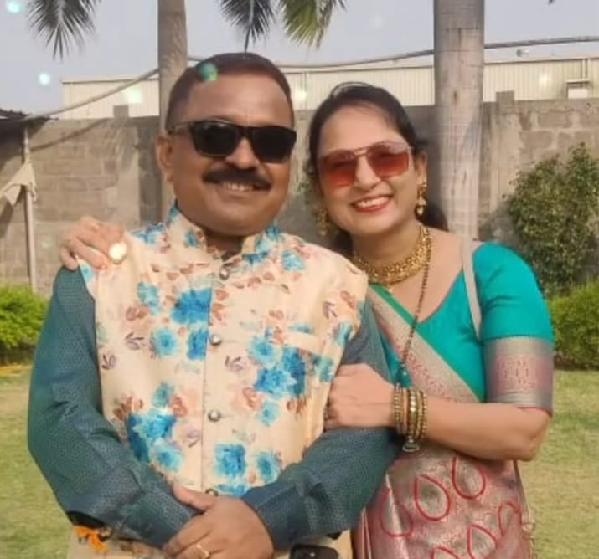
Gopal
Rachna
Endless Affection Award
25th Yagnesh – Bhavini Wedding Anniversary

Slide 51
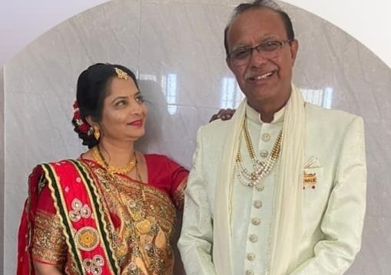
Mayuri
Ketan
Peaceful Pair Award
25th Yagnesh – Bhavini Wedding Anniversary

Slide 53
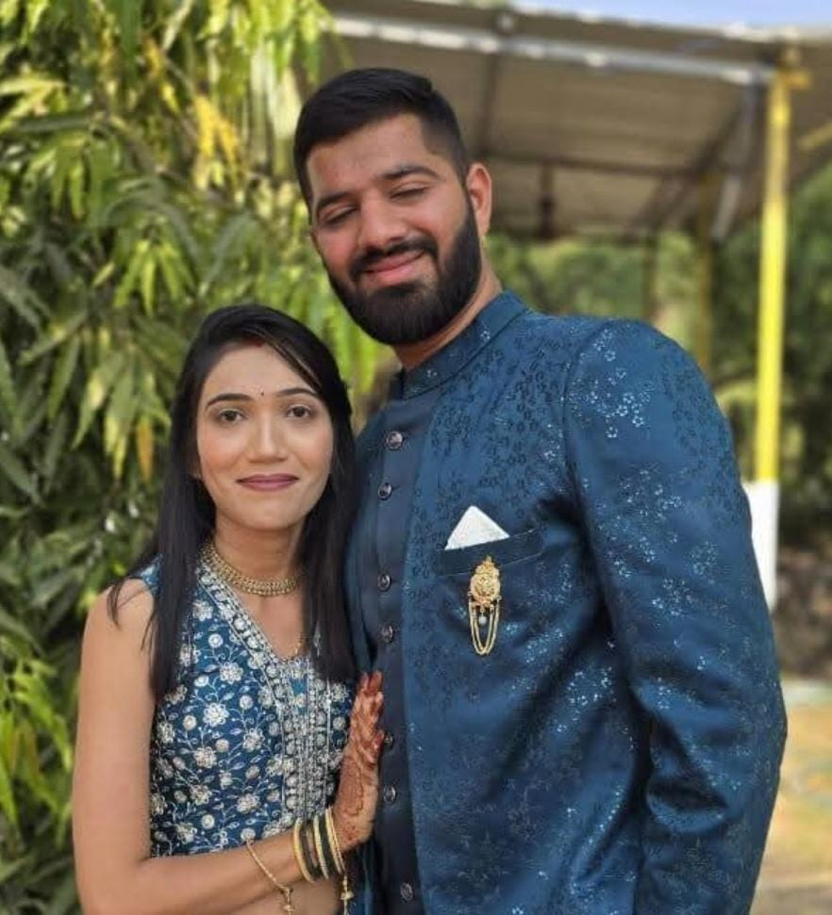
Rachna
Shivagna
True Companionship Award
25th Yagnesh – Bhavini Wedding Anniversary

Slide 55
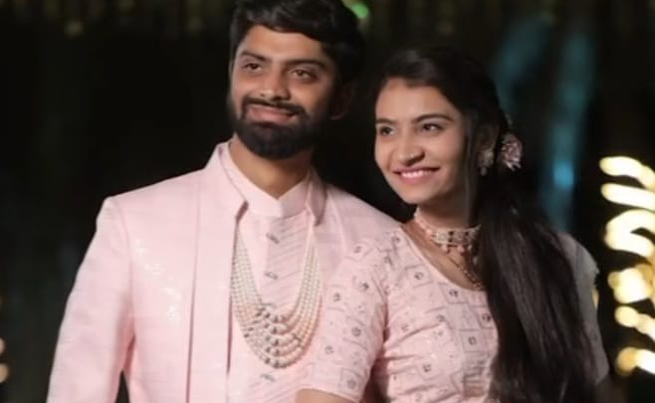
Pranav
Vidhya
Incredible Understanding Award
25th Yagnesh – Bhavini Wedding Anniversary

Slide 57
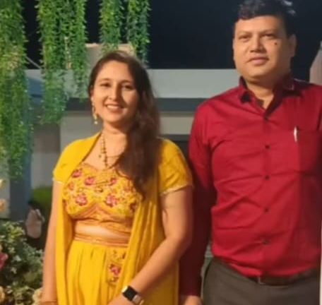
Jigna
Valmik
Soulful Companions Award
25th Yagnesh – Bhavini Wedding Anniversary

Slide 59
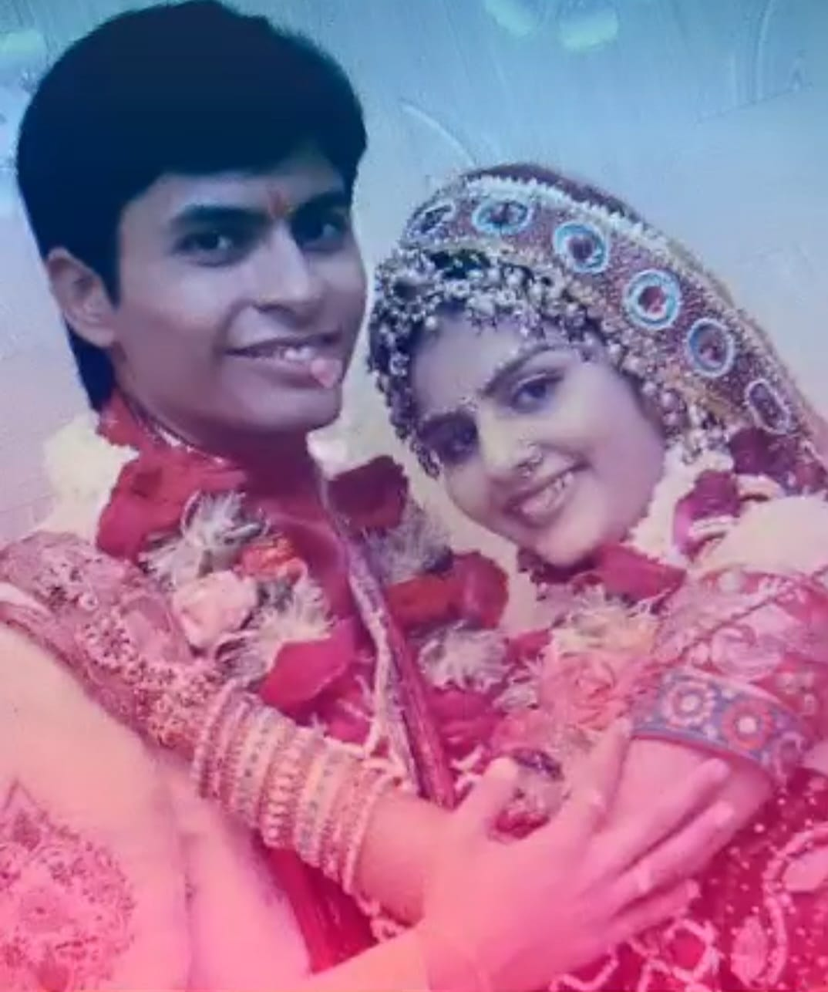
Jimmy
Chandani
Radiant Togetherness Award
25th Yagnesh – Bhavini Wedding Anniversary

Slide 61
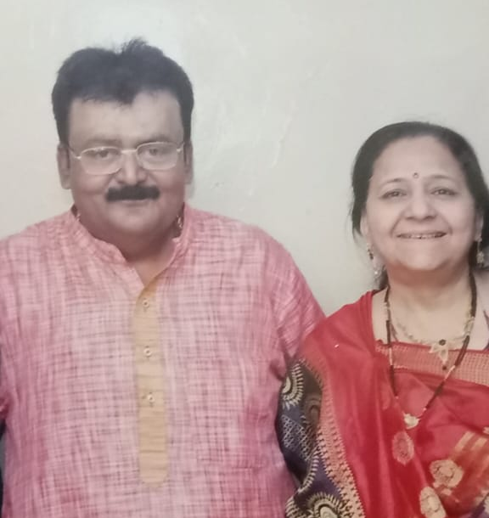
Shailesh
Rupal
Graceful Bond Award
25th Yagnesh – Bhavini Wedding Anniversary

Slide 63
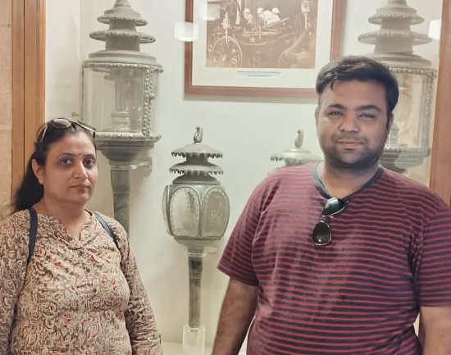
Hiral
Ravi
Perfect Pairing Award
25th Yagnesh – Bhavini Wedding Anniversary

Slide 65
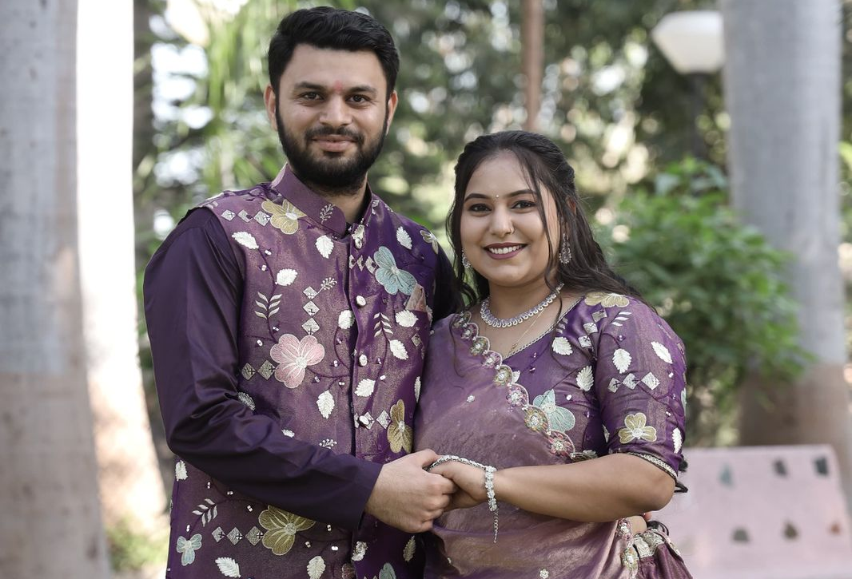
Kahan
Khushali
Joyful Journey Award
25th Yagnesh – Bhavini Wedding Anniversary

Slide 67
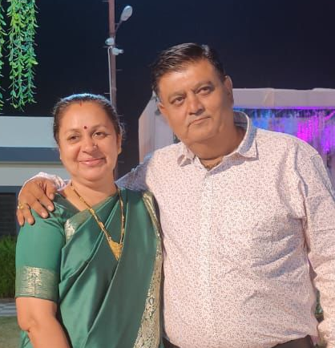
Dharmistha
Raju
Forever Us Award
25th Yagnesh – Bhavini Wedding Anniversary

Slide 69
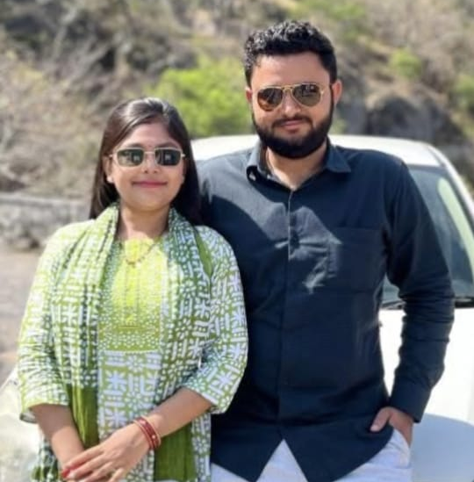
Vaibhavi
Kamal
Forever Us Award
25th Yagnesh – Bhavini Wedding Anniversary

Slide 71
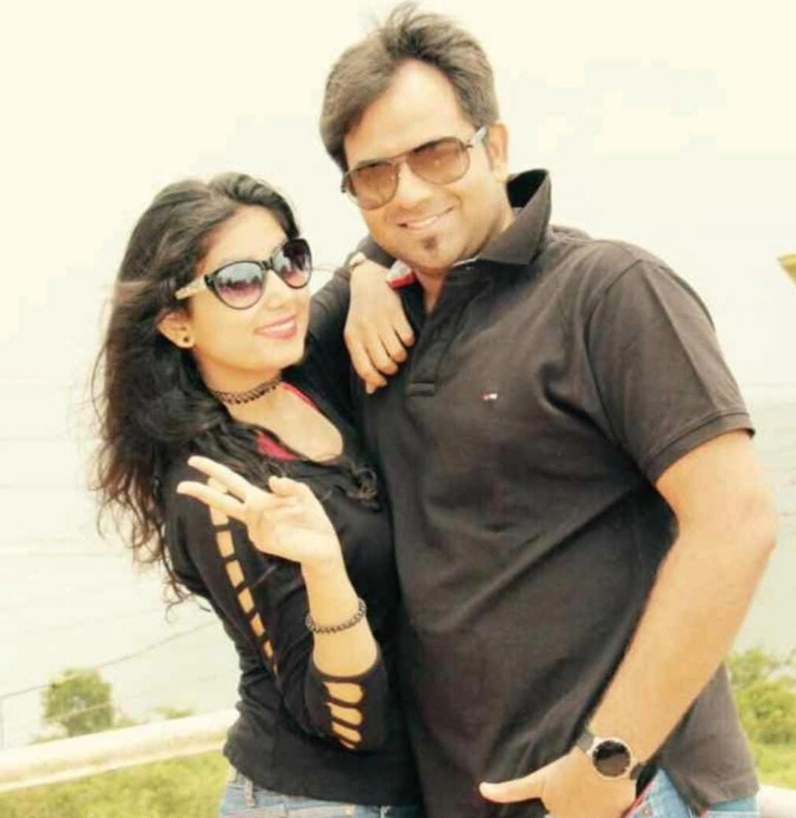
Anjali
Mihir
Made for Each Other Award
25th Yagnesh – Bhavini Wedding Anniversary

Slide 73
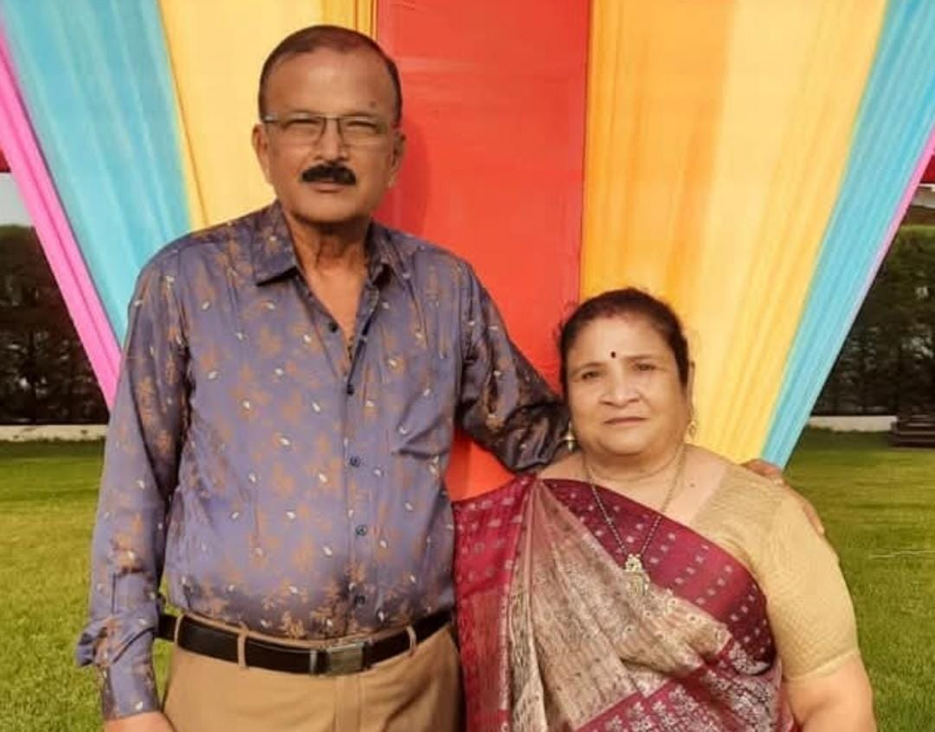
Haresh
Nita
Charming Companions Award
25th Yagnesh – Bhavini Wedding Anniversary

Slide 75
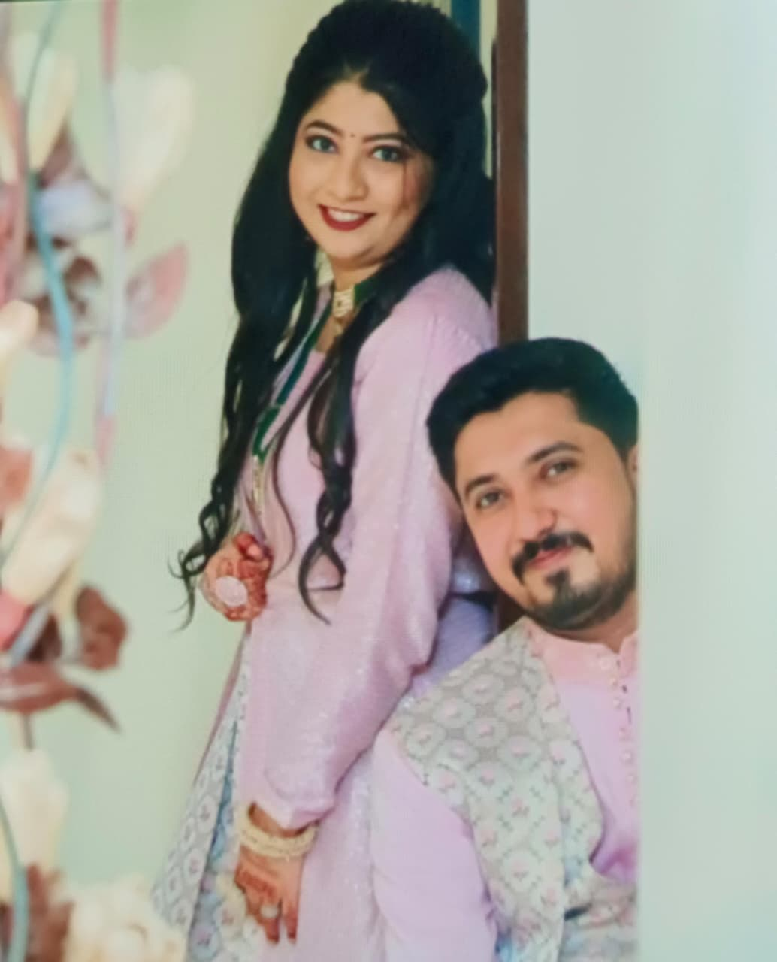
Charmi
Karan
Ever After Together award
25th Yagnesh – Bhavini Wedding Anniversary

Slide 77
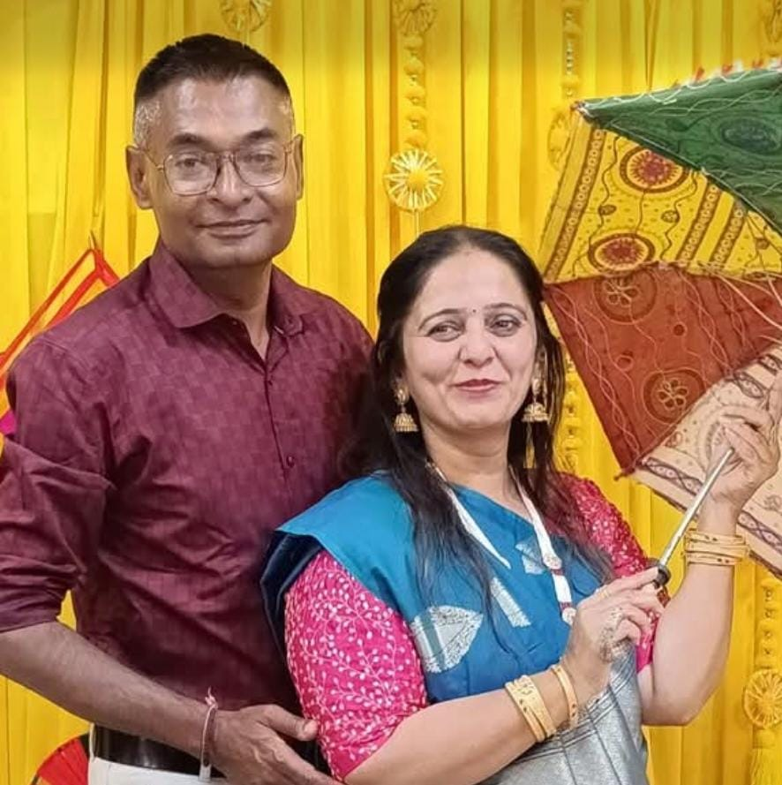
Kalpesh
Jigna
Perfect Union Award
25th Yagnesh – Bhavini Wedding Anniversary

Slide 79
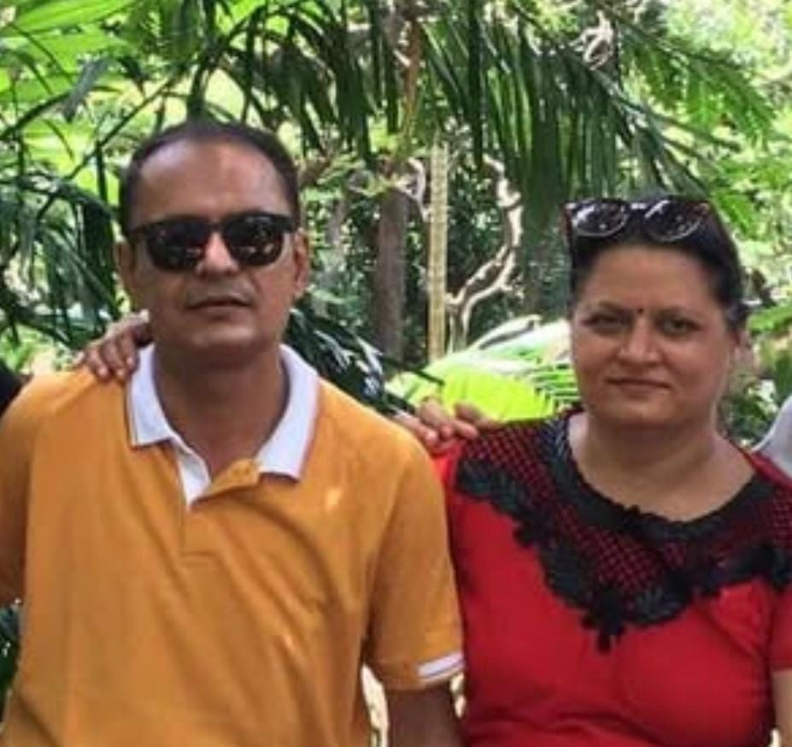
Pappu
Dimpal
Perfect Match Award
25th Yagnesh – Bhavini Wedding Anniversary

Slide 81
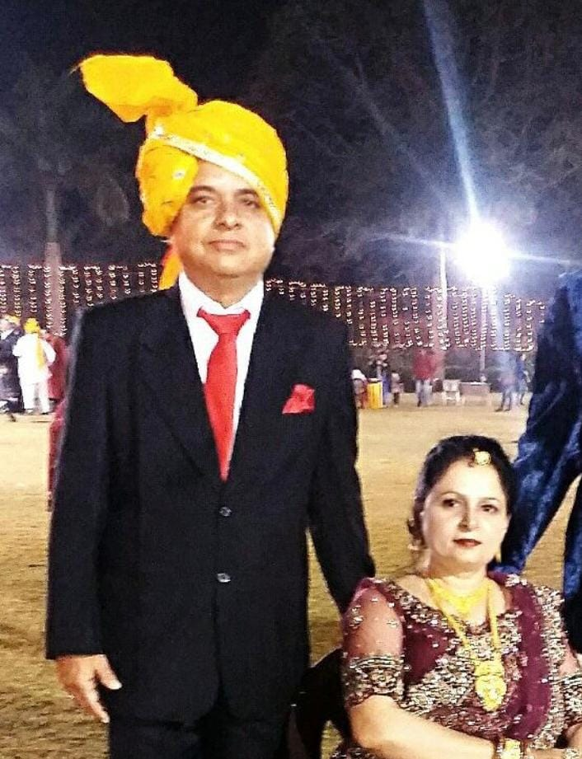
Paresh
Alpa
Bond of a Lifetime award
25th Yagnesh – Bhavini Wedding Anniversary

Slide 83
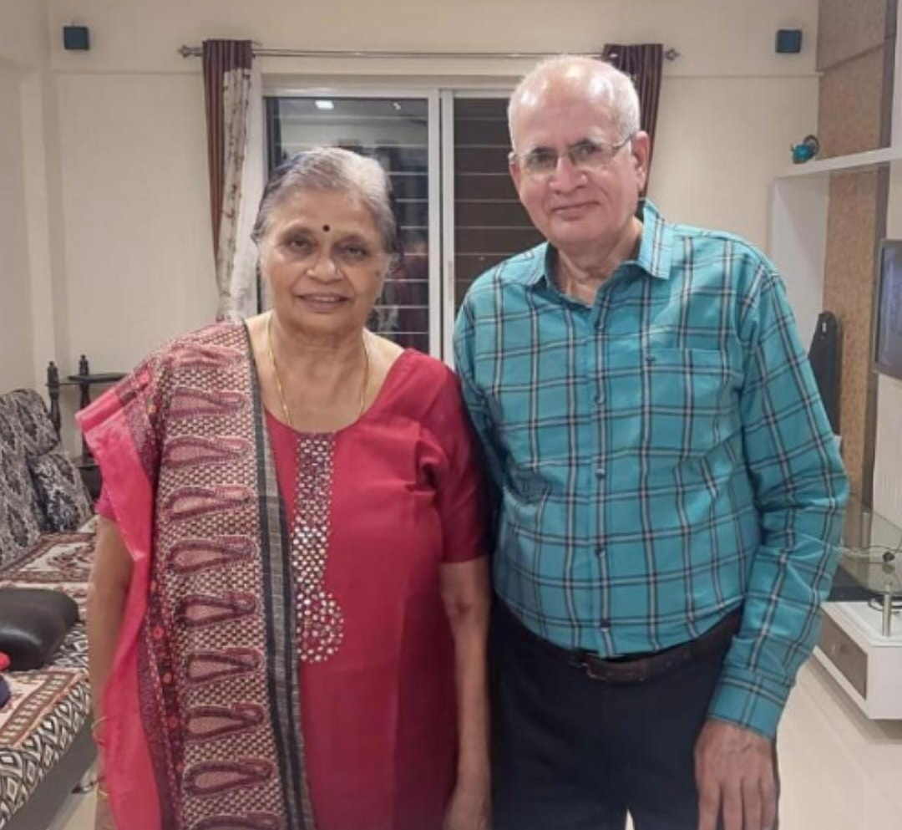
Veena
Chitranjan
Best Vibes Together Award
25th Yagnesh – Bhavini Wedding Anniversary

Slide 85
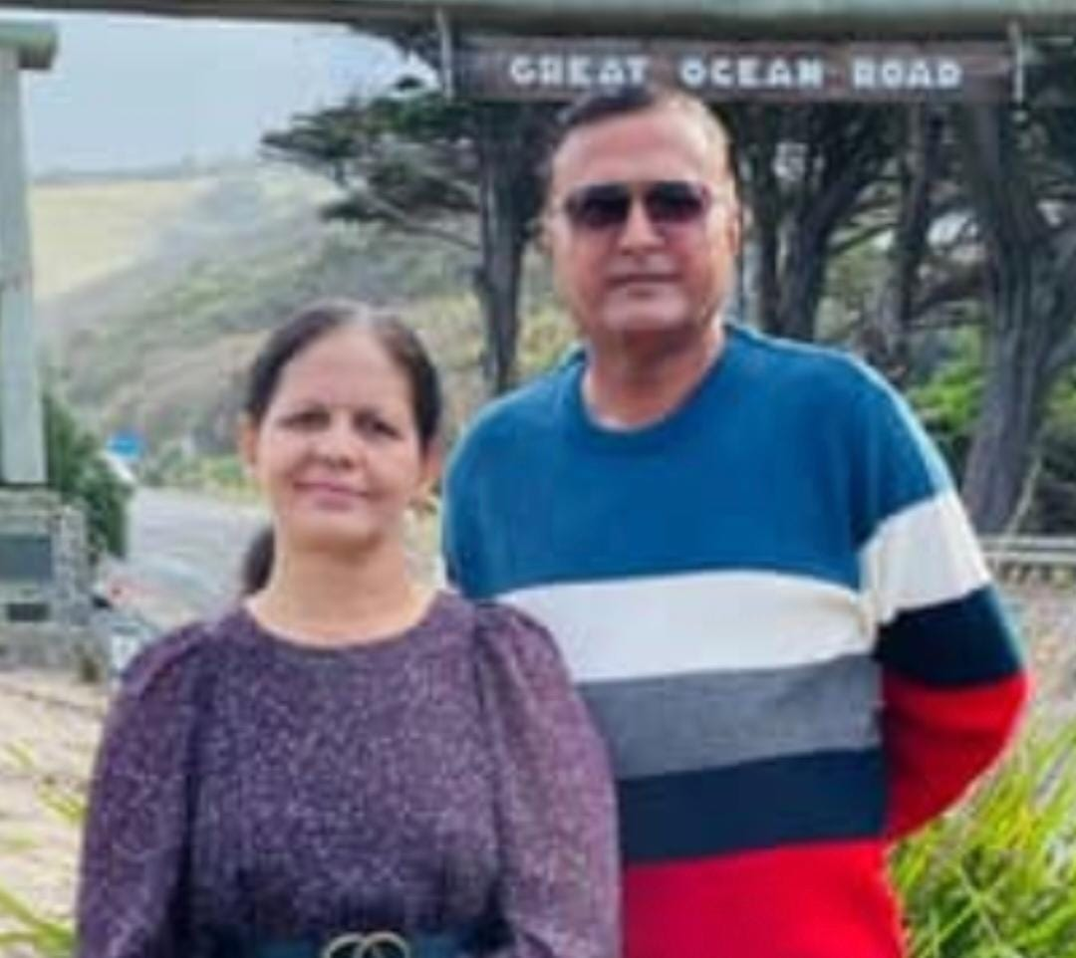
Jyoti
Nilu
Jodi No.1 Award
25th Yagnesh – Bhavini Wedding Anniversary

Slide 87
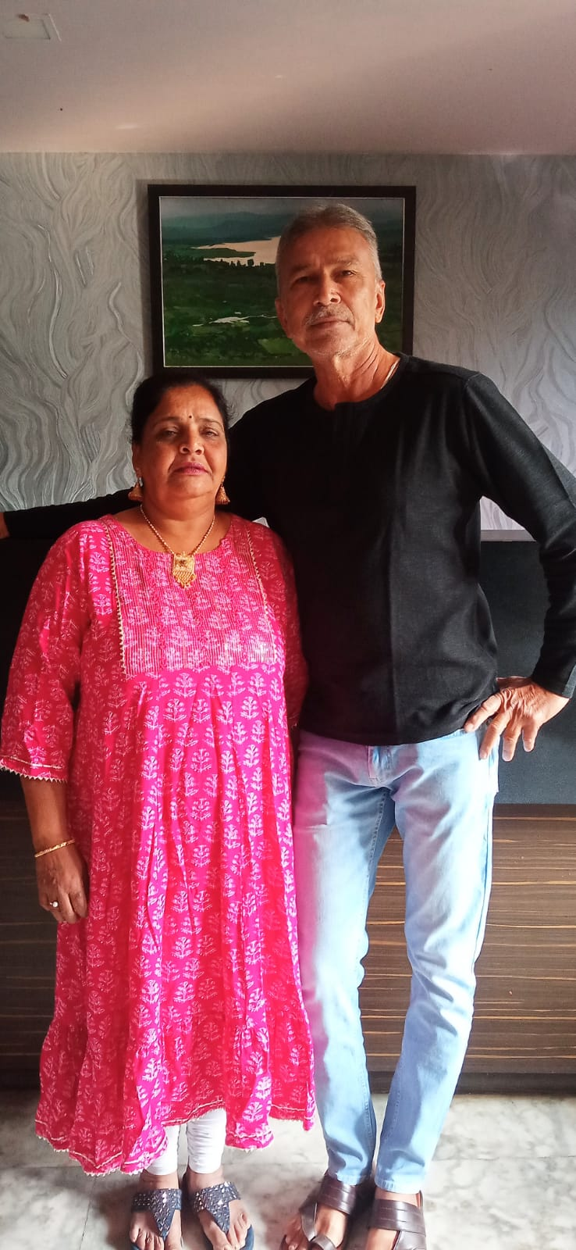
Yogita
Manu
Silent Strength Award
25th Yagnesh – Bhavini Wedding Anniversary

Slide 89

Kavan
The Silent Star
25th Yagnesh – Bhavini Wedding Anniversary

Slide 91
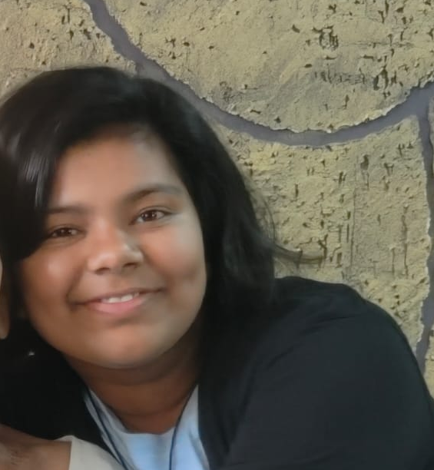
Diya
Light of the House
25th Yagnesh – Bhavini Wedding Anniversary

Slide 93
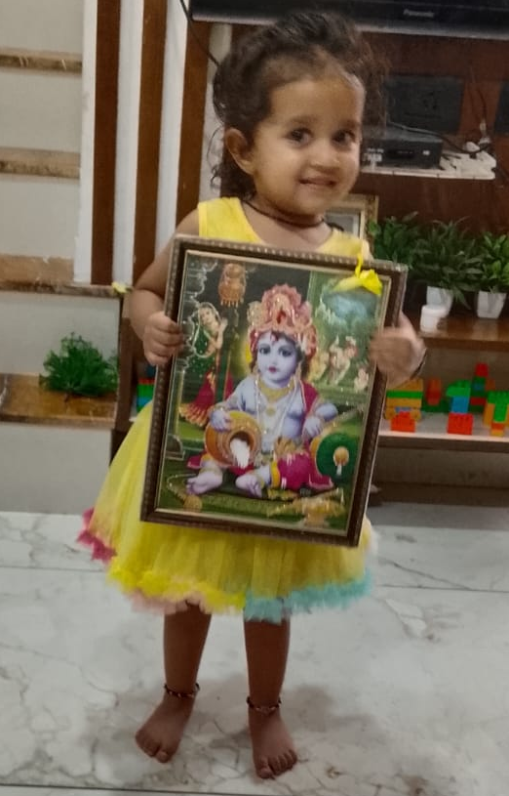
Shreeja
Spark of Grace
25th Yagnesh – Bhavini Wedding Anniversary

Slide 95
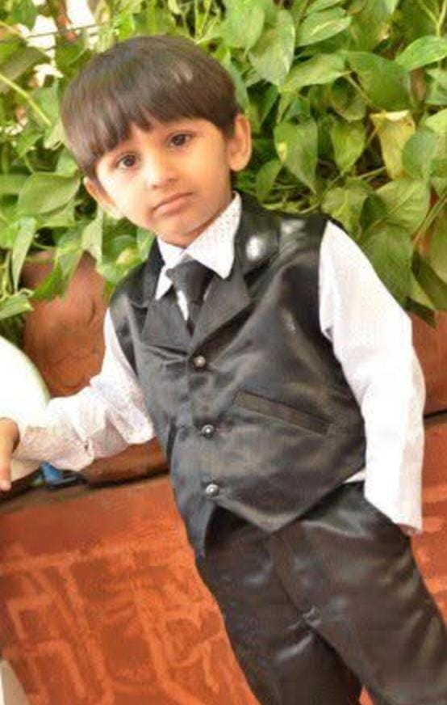
Rudraksh
The Wise Soul
25th Yagnesh – Bhavini Wedding Anniversary

Slide 97
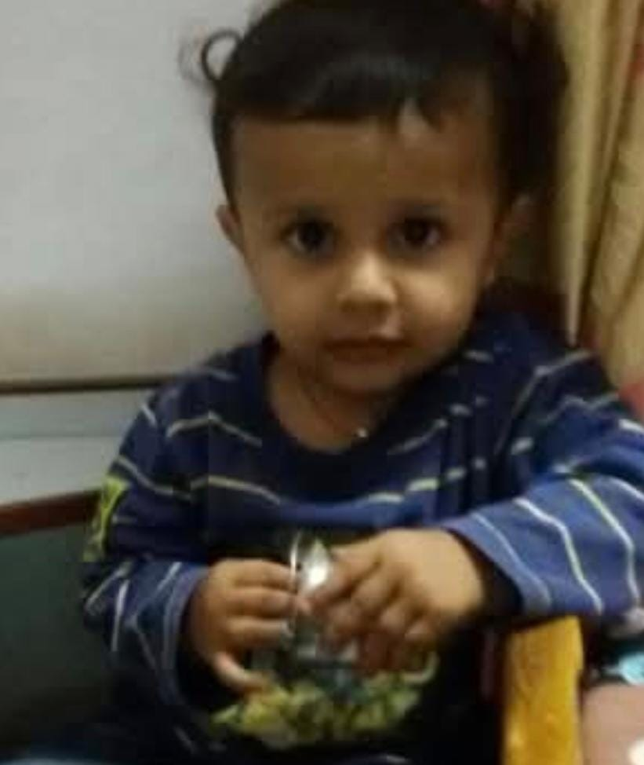
Vedant
Thoughtful Spark
25th Yagnesh – Bhavini Wedding Anniversary

Slide 99
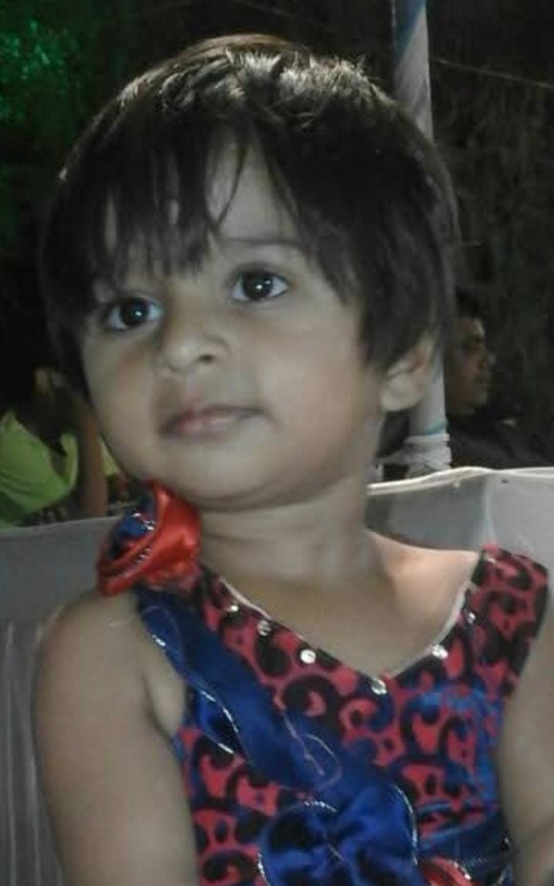
Priyanshi
The Soft Melody
25th Yagnesh – Bhavini Wedding Anniversary

Slide 101

Isha
Sweet Sparkle
25th Yagnesh – Bhavini Wedding Anniversary

Slide 103
Kavan
The Silent Star
25th Yagnesh – Bhavini Wedding Anniversary

